Slide 1
VX423 Final Presentation
SIIDI
Pan Chongdan
Apr. 17th

Slide 2
Introduction of SIIDI
Sustainability Research
Transportation Ecosystem
Urban Quality Living
High Tech Big Data Service
Dutch Sustainability Day
Innovation Service
Mental Management
Innovative Thinking
Leadership Execution
Field Practice
Shanghai International Institute of Design and Innovation
A consulting company provides design and innovation service for entrepreneurs and start up companies to incubate projects.

Slide 3
Business Function
Marketing
Service: workshop and advice from design thinking
Price: Reasonable
Place and distribution channel: At the company or public area.
Promotion: workshop and Internet
Strategy: Use workshop to attract customers and help them incubate projects
Customers
Workers from other companies
Entrepreneurs
Start up company

Slide 4
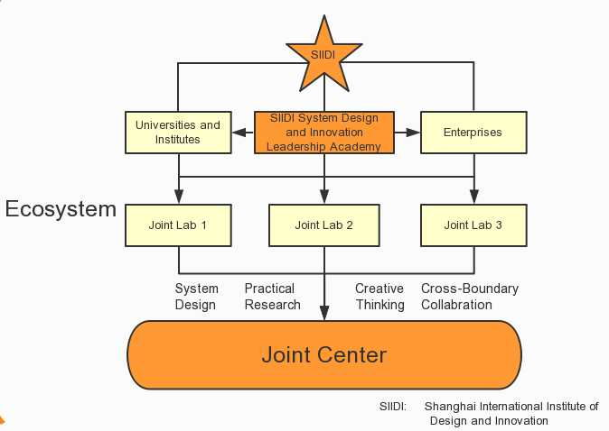
Business Function
Finance and Accounting
First funded from government
Gain profits from workshops and service for its customers
Intend to make more social welfare than profits
Human Recourses
Professors from famous university
Interns with specific skills
Mentors with design thinking strategy
Partners from company alliances

Slide 5
Intrapreneurship Environment
Communication
Hold meeting regularly
Use cell phone or e-mail to make online communication
Policies
Projects should be environment and social friendly
Workers are free to choose the intrapreneurship project
Process and Procedure
Make a clear record and plan after meeting
Field practice is essential for projects
Culture
Design thinking is familiar to every worker
White boards are everywhere for workers to draw their ideas.

Slide 6
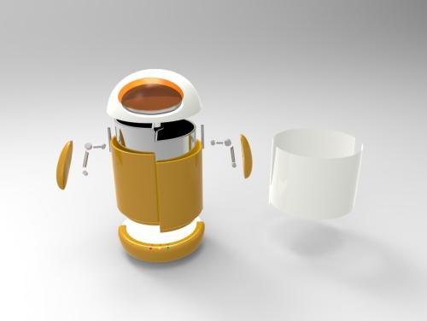
Waste Management Project
Abstract
Mainly incremental innovation
Domain redefinition for community waste management process
Create a smart bin to help citizens to classify their garbage
Use mobile phone or QR code to monitor the status of citizens’ classification
Use GPS to guide garbage truck to collect rubbish with higher efficiency

Slide 7
Strategy and Venturing
SIIDI
Help make contact to relevant units to get more resources and information
Lead a field practice to gain more information
Set up a joint lab with interns and the company to make system design for the project
Government
Help found SIIDI
Provide access to relevant units and place for field practice
Professors from University
Give SIIDI some professional advice and some solution to garbage problem
Interns from SJTU
Help design the implementation of the project with mentors from SIIDI
Do investigation online
Make a prototype with SIIDI
Cooperative Corporate Venturing
Hong Kong startup
Find SIIDI to get innovative and design advice to realize the project

Slide 8
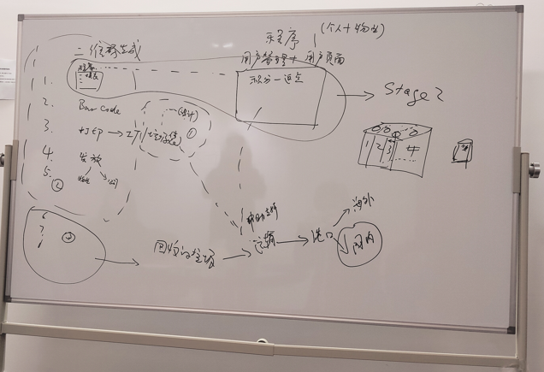
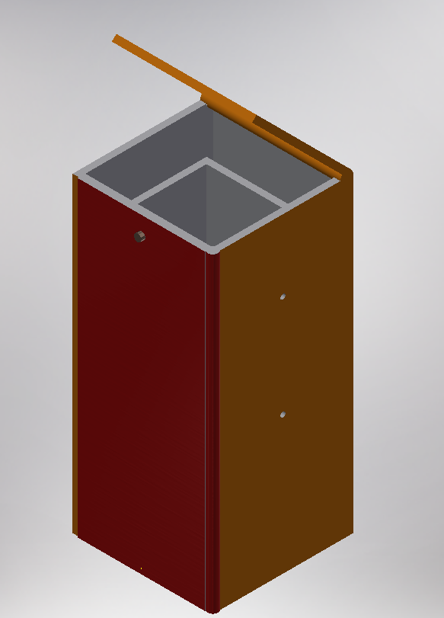
Our work and incremental Innovation
Design Part
Help customer design the total procedure of the implementation based on design thinking
Sketch a concept map for the smart bin
Plan field practice based on design thinking to make the waste management system suitable for all kinds of people

Slide 9
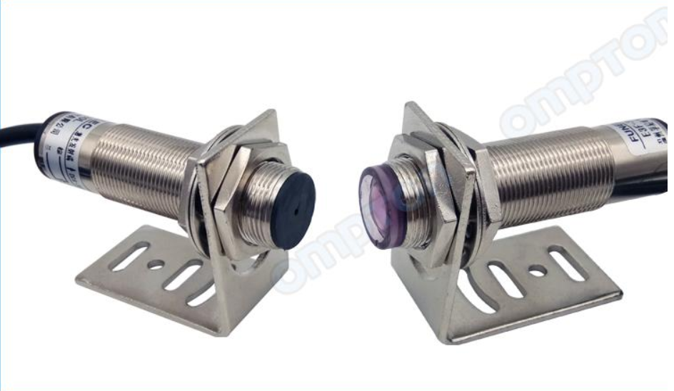
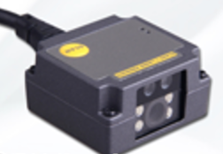
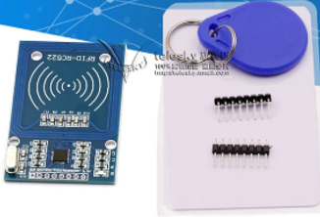
Our work and incremental Innovation
Prototype Part
Use laser sensor to monitor the volume of garbage with high accuracy
Make research to PLA garbage bag to make the project more environment friendly
Do investigation on batteries to improve the smart bin’s efficiency

Slide 10
Main Problem Analysis
Time Consuming Project
The project has started for more than one year but it’s still in the design stage.
Lots of efforts has been taken to get access to relevant units and field practice.
A lot of long meetings have been hold but the progress is very slow.
Workers lack specific experience and skills about this project.
Reason Analysis
Unclear company orientation. Consulting company or technology company?
No clear plan and schedule for the project’s progress.
Inefficiency of communication and meeting.
Requirement for mentors in fields beyond design, such as experts with engineering experience and skills.

Slide 11
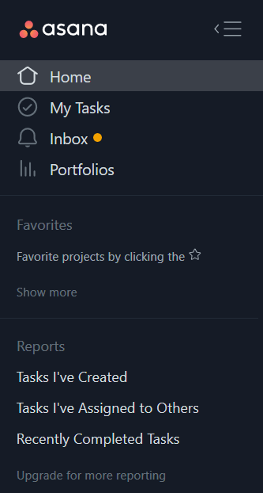
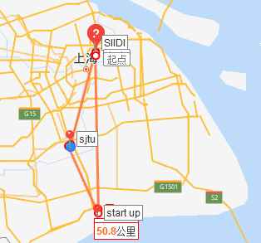
Possible Process Innovation
Improvement for Communication
Have a clear schedule for meeting, including online meeting
Choose a place convenient for everyone for face to face meeting
Use some online management software to update everyone’s work progress everyday

Slide 12
Possible Process Innovation
Strategic Renewal
Clarify the company’s orientation in this project
Focus more on the macro system design and lead field practice
Bring in more partners like manufacturers or technology developers to speed up the process for prototype
Strengthen the contacts between partners including startup, interns and relevant units
Start up company
Design the project
SIIDI
Make the product
Universities and Interns
Develop the prototype
Manufacturers and developers

Slide 13

Conclusion
Precious internship opportunity
Gain experience about how company operates and incubates project
Get a general idea of process for design thinking
Learn the importance of field practice.
Generate a critical thinking about process and strategy for the company
Waste management project
Be part for an entrepreneurship project in real life
Apply engineering and entrepreneurship knowledge to practical project

Slide 14
Thank you

Slide 15
Reference
http://map.baidu.com
http://www.siidi.cn
http://app.asana.com

